Slide 1
Action Plans

Slide 2
Contents

Slide 3
Methodology

Slide 4
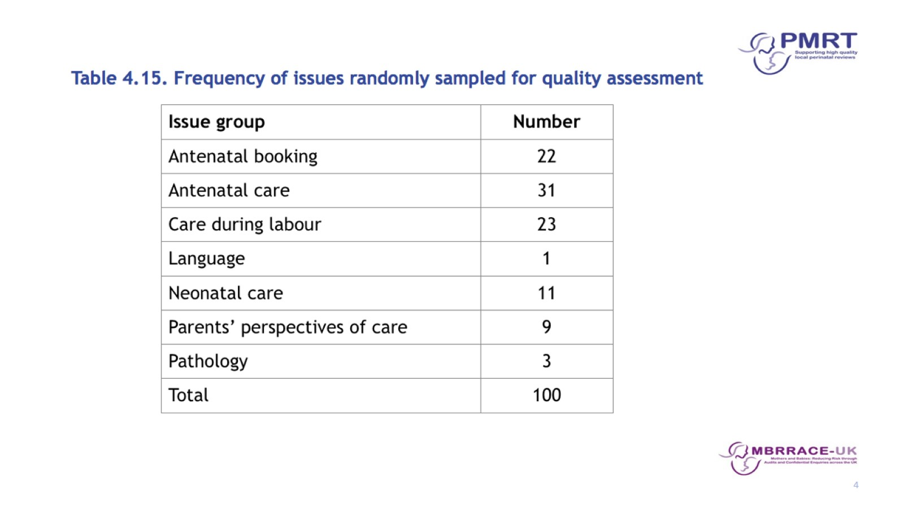

Slide 5
Results

Slide 7
Action Plans with
Greatest Impacts on Outcomes

Slide 8
SMART Actions

Slide 11
Action Strength

Slide 18
Action Impact

Slide 21
What makes a good action plan?

Slide 22
Summary

Slide 23
Acknowledgements

Slide 24
MBRRACE-UK/PMRT collaboration

Slide 25
PMRT tool development group members

