Slide 1
Messages for the care of women who died between six weeks and a year after pregnancy

Slide 2
The women who died: UK 2011-13

Slide 3
Causes of maternal death 2009-13

Slide 4
Late deaths

Slide 5
Late Maternal Deaths 2009-13

Slide 6
Age and Deprivation

Slide 7
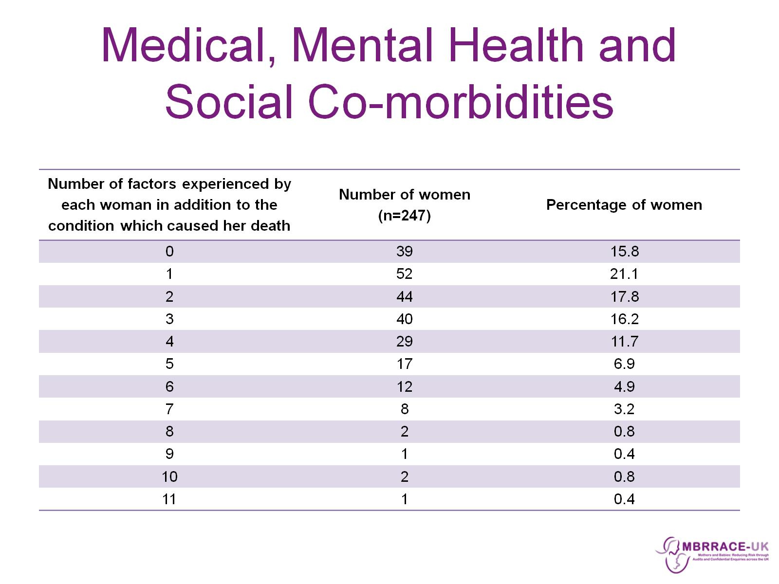
Medical, Mental Health and Social Co-morbidities

Slide 8
Review of late deaths

Slide 9
Overview of care and lessons to learn

Slide 10
Overview of care and lessons to learn

Slide 11
Pre Pregnancy care

Slide 12
Pre Pregnancy care

Slide 13
Infertility

Slide 14
Antenatal Care – example of good care

Slide 15
Antenatal care

Slide 16
Initial Emergency Care

Slide 17
Transfer – Between Wards

Slide 18
Transfer between hospitals

Slide 19
Transfer guidance

Slide 20
Senior review

Slide 21
Consultant to Consultant referrals

Slide 22
Consultant to Consultant referrals

Slide 23
Postnatal care

Slide 24
Postnatal Care

Slide 25
Repeated attempts to access care

Slide 26
Echoes of sepsis chapter last year

Slide 27
Communication

Slide 28
Good communication can happen

Slide 29
Multiple morbidity and socially complex lives

Slide 30
Key messages

Slide 31
Key messages

Slide 32
Key messages

