Slide 1
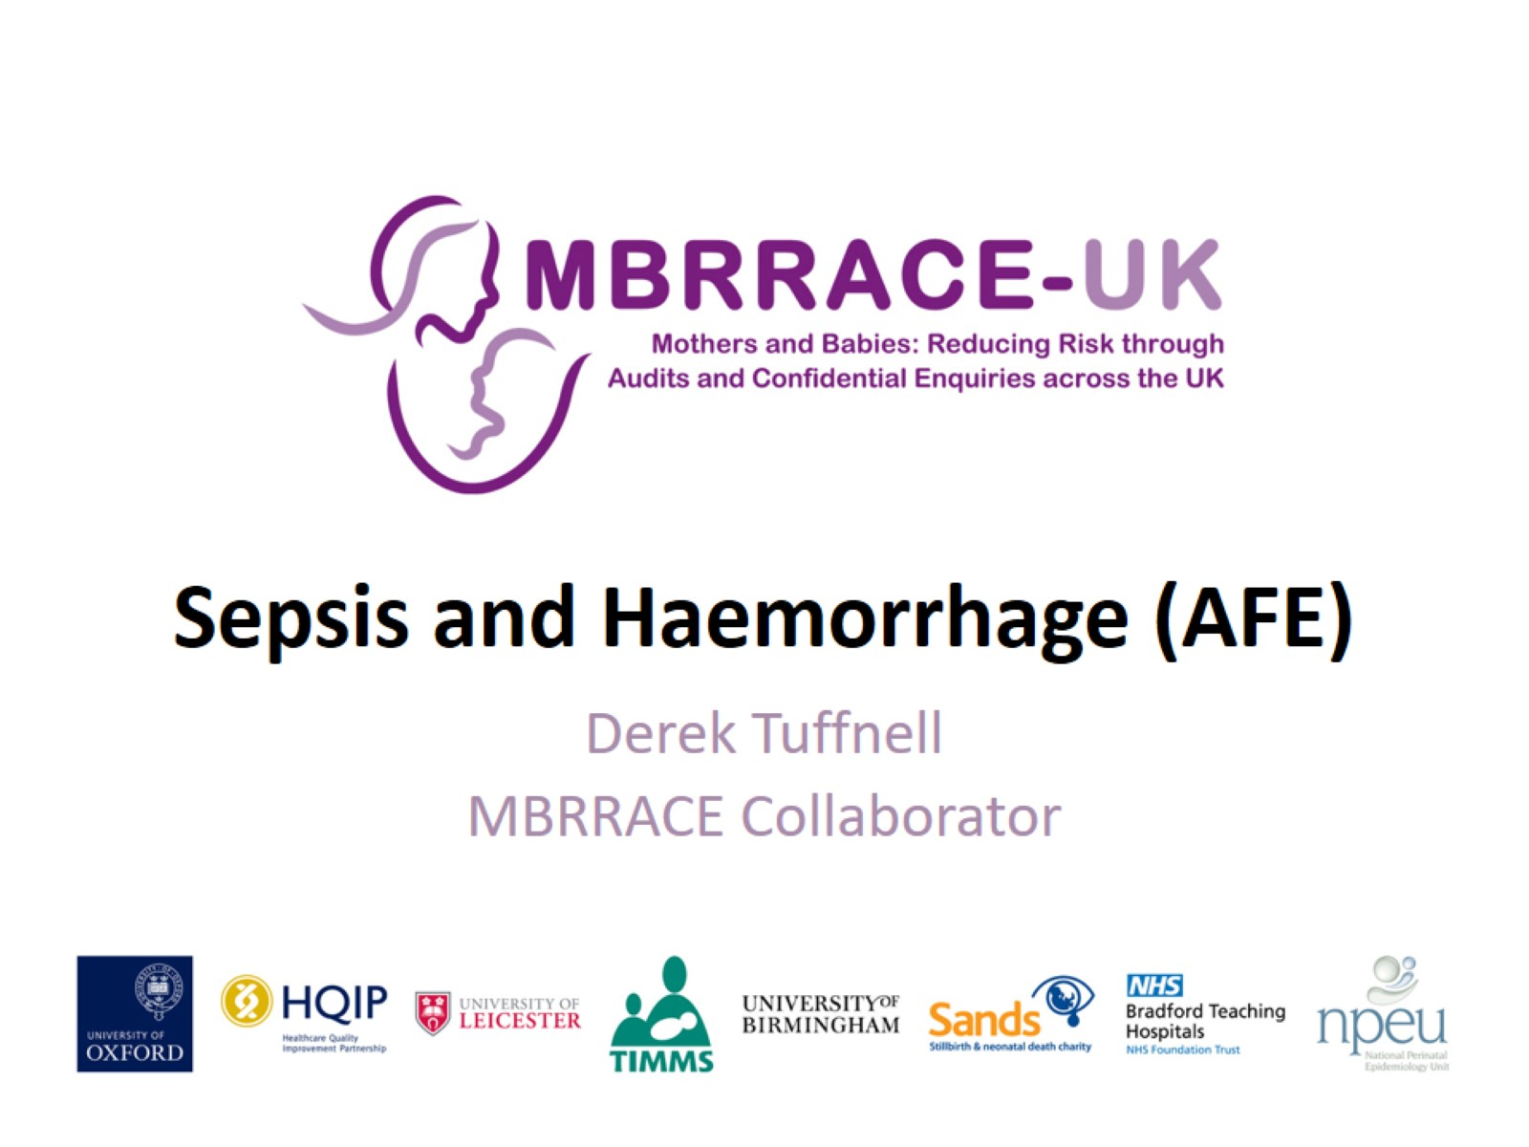
Sepsis and Haemorrhage (AFE)

Slide 2
Maternal mortality rate due to sepsis per 100,000 maternities, UK 2013-15

Slide 3
Sepsis 2013-15

Slide 4
Influenza

Slide 5
Think Sepsis

Slide 6
PPROM – Erythromycin does not treat sepsis

Slide 7
Recommendations

Slide 8
Women who died from haemorrhage UK (1994-2008) and UK/Ireland (2009-15)

Slide 9
AFE

Slide 10
Haemorrhage lessons

Slide 11
Retained placenta

Slide 12
7 women with hyperstimulation

Slide 13
Misoprostol doses

Slide 14
Placenta Praevia accreta

Slide 15
8 women died from accreta

Slide 16
Hysterectomy

Slide 17
Summary

