Slide 1
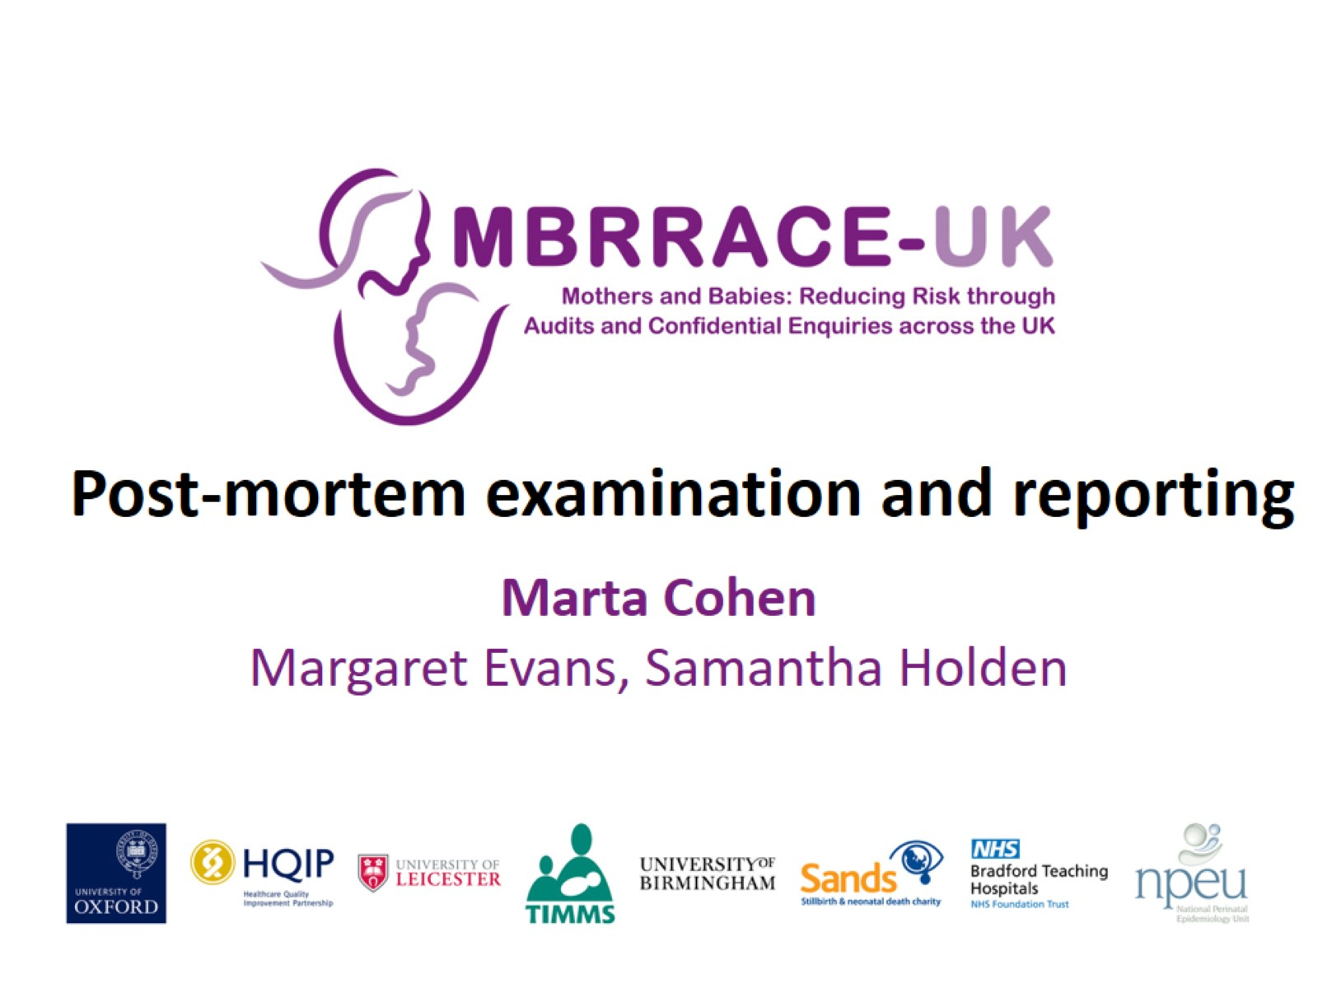
Post-mortem examination and reporting

Slide 2
Introduction: Why conduct a PM examination?

Slide 3
Extent of the examination

Slide 4
Diagnostic yield of placental examination

Slide 5
MDT

Slide 6
Key Findings - 1

Slide 7
Key Findings - 2

Slide 8
Vignette: specialist examination not available during the clinical review

Slide 9
Vignette:In 2/41 PMs the placenta was “lost” or “disposed of”

Slide 10
Involvement of HM Coroner or Procurator Fiscal

Slide 11
Vignette: Coroner/Procurator Fiscal PM report not available to inform hospital review

Slide 12
Placental reports

Slide 13
Examination by type of jurisdiction and perinatal death

Slide 14
Conclusions

