Slide 1
Care of women from vulnerable groups

Slide 2
Vulnerability

Slide 3
The women who died 2014-16

Slide 4
Late maternal deaths UK 2014-16

Slide 5
Other characteristics of women who died

Slide 6
Other characteristics of women who died

Slide 7
Other characteristics of women who died

Slide 8
Maternal deaths

Slide 9
Severe and multiple deprivation

Slide 10
Severe and multiple deprivation

Slide 11
Judgements based on history

Slide 13
Co-morbid depressive illness

Slide 15
Opioid prescription

Slide 16
Opioid prescription

Slide 17
Homicide and domestic abuse

Slide 18
Homicide and domestic abuse

Slide 19
Summary

Slide 20
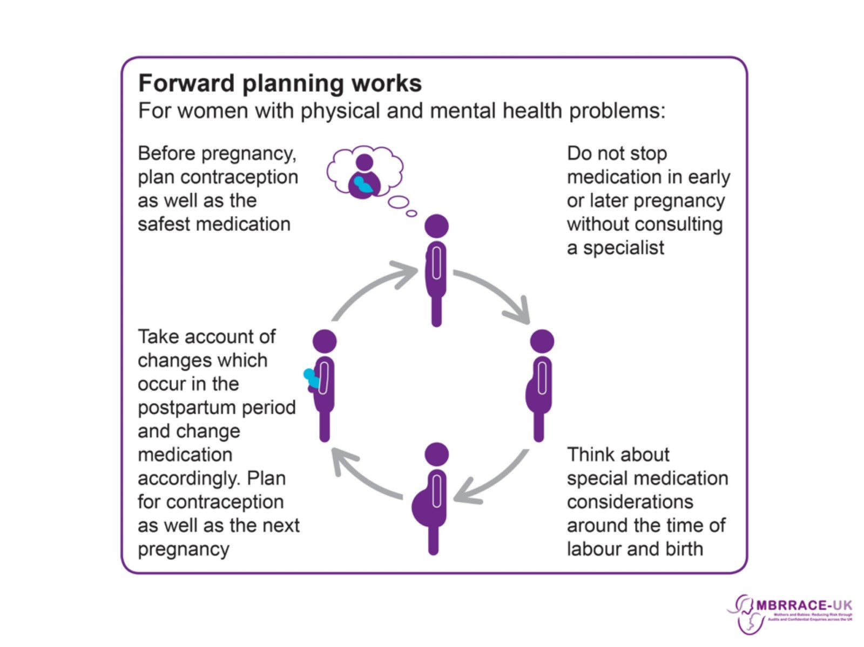

Slide 21
Messages for care

